Slide 1
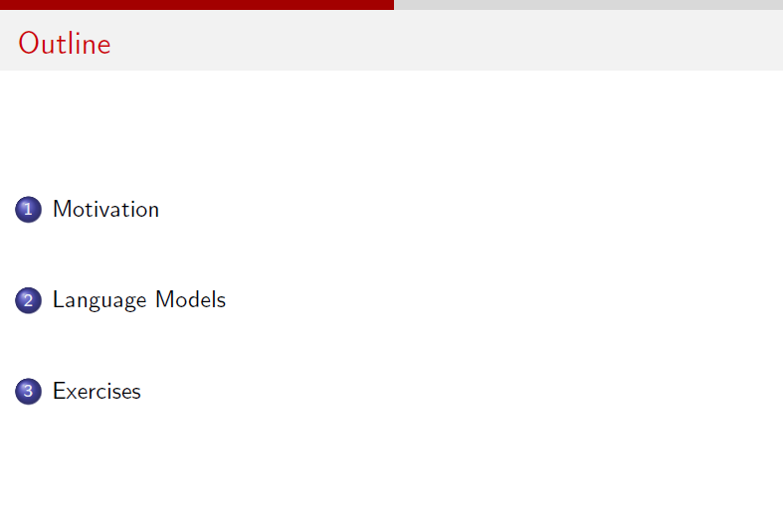

Slide 2
Note: The problems have been solved in the notebook. Please refer to it.

Slide 3
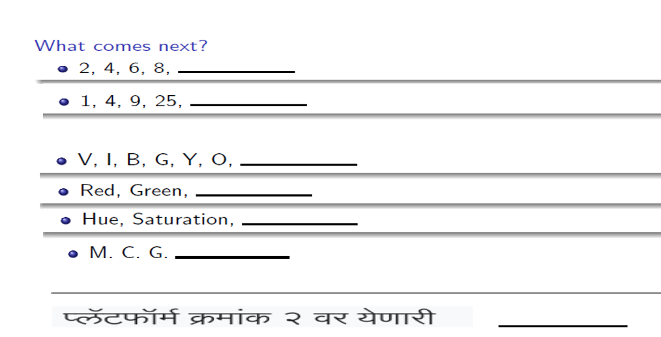

Slide 4
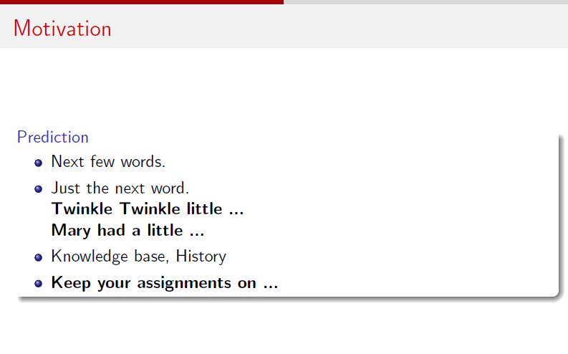

Slide 5
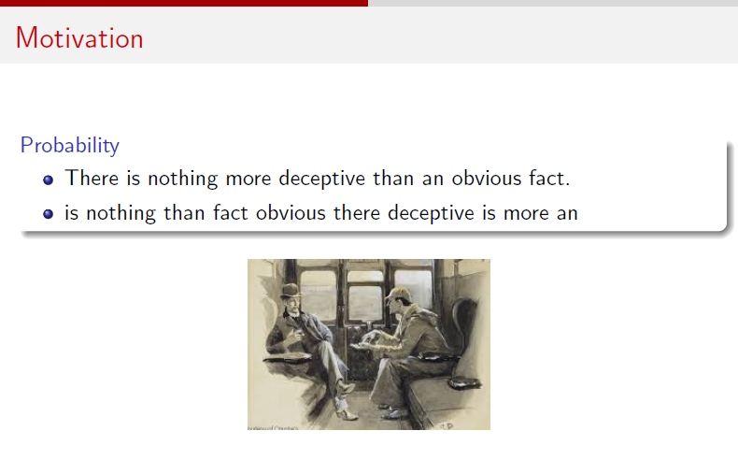

Slide 6
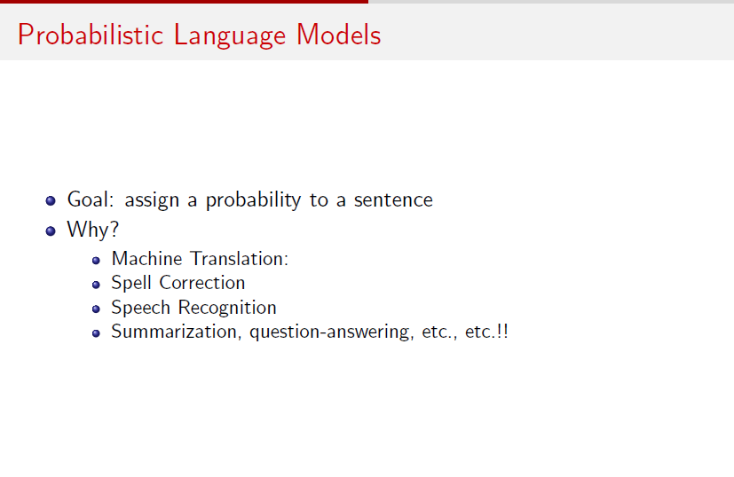

Slide 7
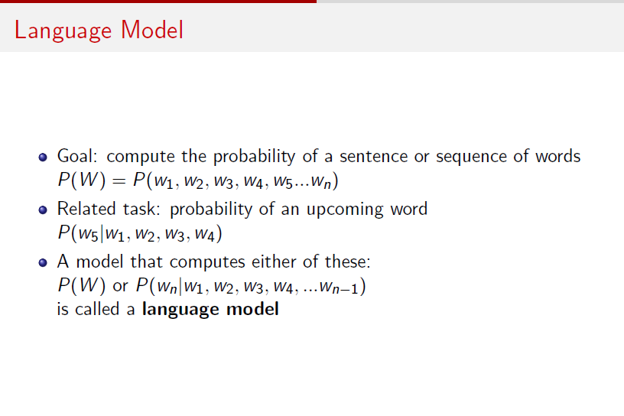

Slide 8
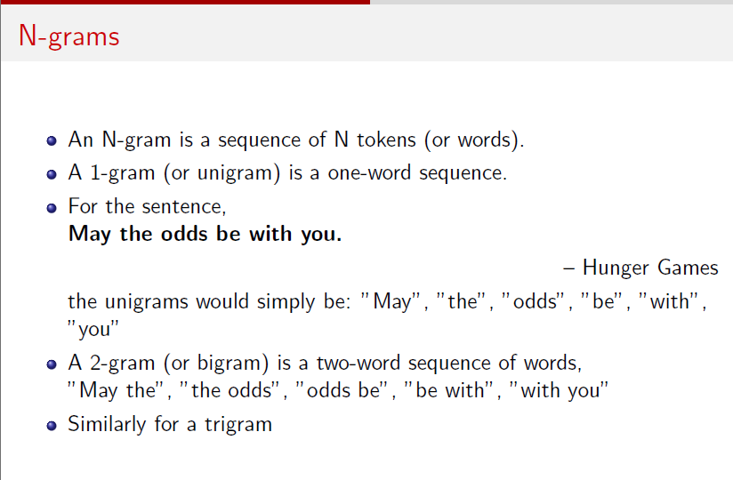

Slide 9
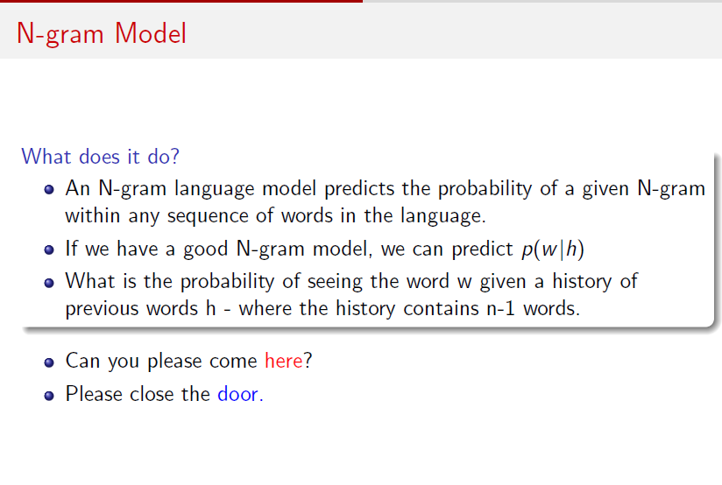

Slide 10
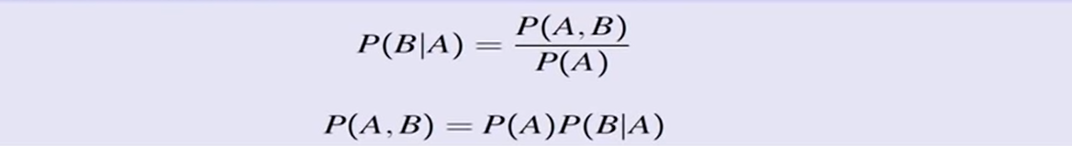
The Chain Rule
Conditional probabilities
More variables
The Chain Rule in General:
The chain rule in general:

Slide 11
The office is about fifteen minuets from my house
Use a language model
P(about fifteen minutes from) > P(about fifteen minuets from)

Slide 12
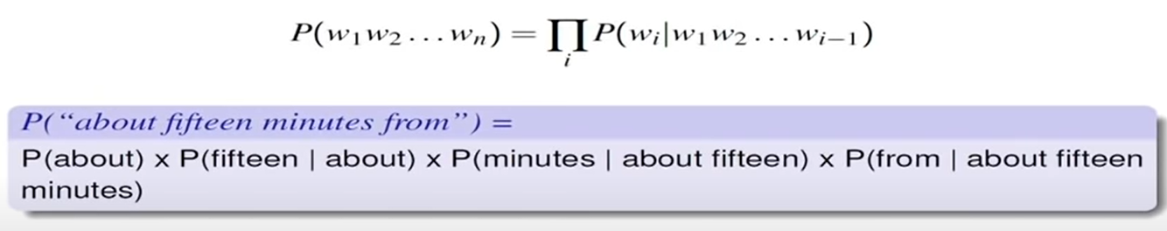
Probabilities of words in sentences

Slide 13
Estimate these probabilities values
Problem
we may never see enough data for estimating these

Slide 14
Markov assumption

Slide 15
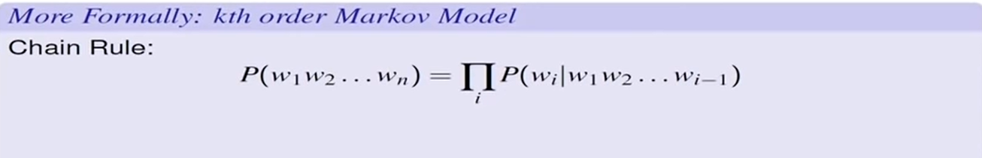
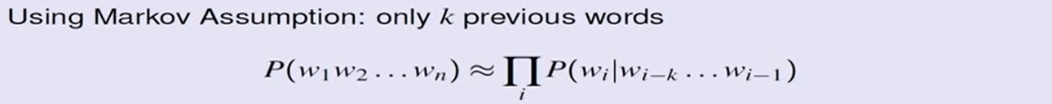
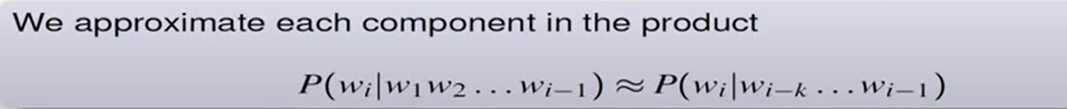
Markov assumption

Slide 16
N-Gram models
An N- Gram model uses only N-1 words of prior context.
P(office| about fifteen minutes from)
Unigram : P(office)
Bigram : P(office| from)
Trigram : P(office | minutes from)
Markov model and Language Model
An N- gram model is an N-1 order Markov Model

Slide 17
Unigram : No history is used
Bi- gram : One word history
Tri- gran: Two word history
Four- gram: Three word history
Five- gram: Four word history

Slide 18
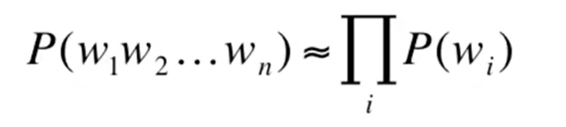
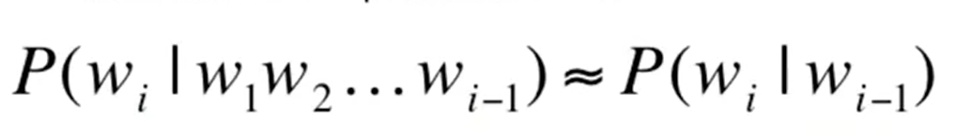
Unigram model
Bigram model

Slide 19
N-Gram models
We can extend to trigrams, 4- grams, 5- grams
In general, an insufficient model of language:
language has long- distance dependence:
“The computer which I had just put into the machine room on the fifth floor crashed.”
In most of the applications, we can get away with N- gram models.

Slide 20
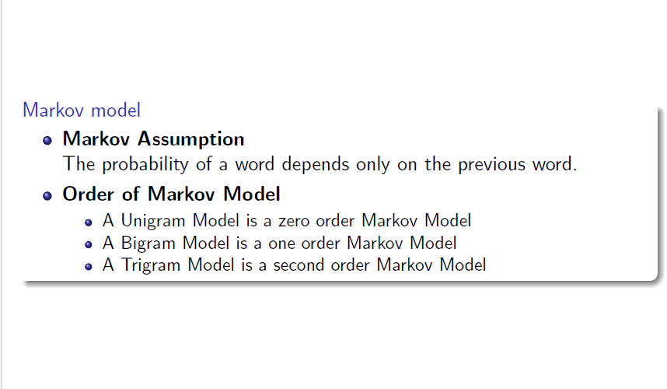

Slide 21
Unigram
Unigram : No history is used
“about five minutes from….”
Assume in corpus dinner word is present with highest probability.
Unigram does not take into account probabilities with previous words like from, minutes.
Unigram will predict dinner.
“about five minutes from dinner”

Slide 22
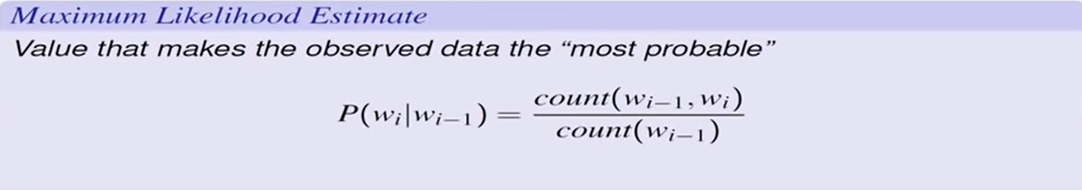
Estimating N- Grams probabilities (Bi-gram)

Slide 23
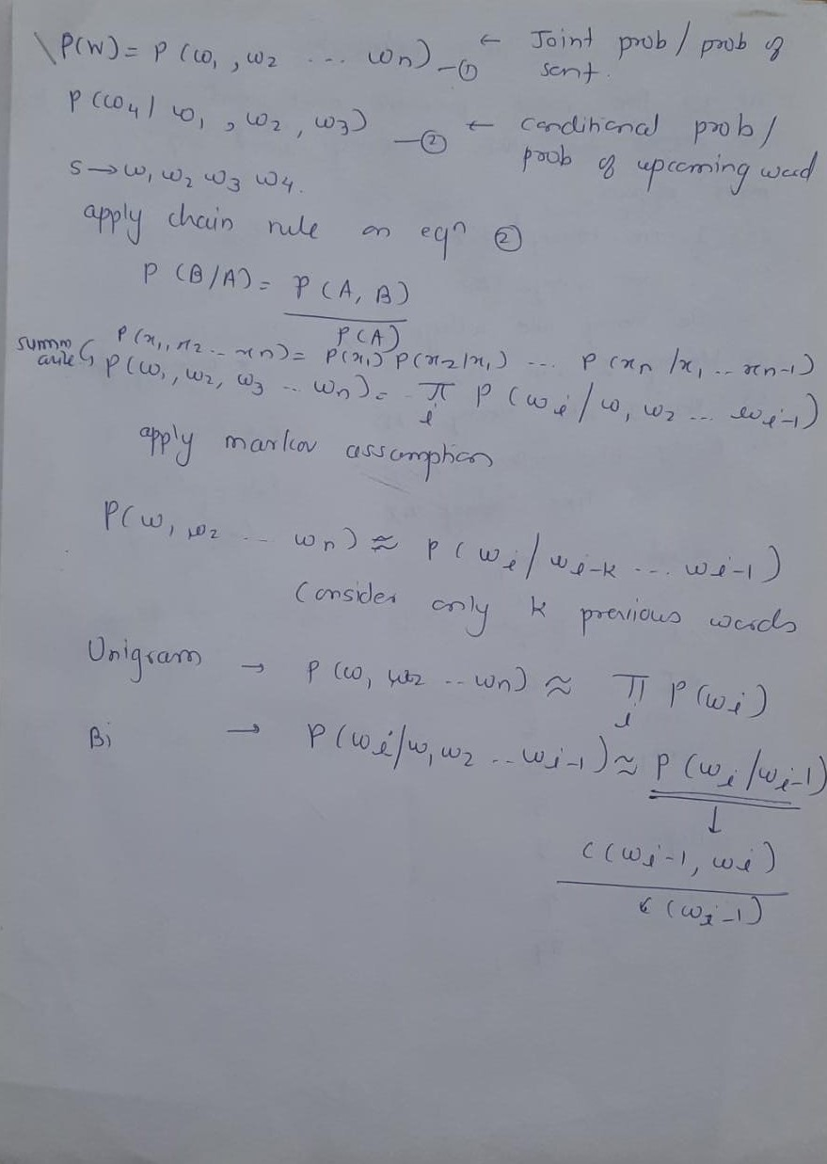

Slide 24
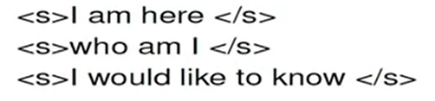
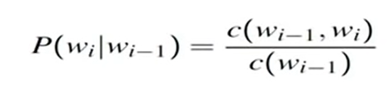








Exercise (Bi-gram)

Slide 25
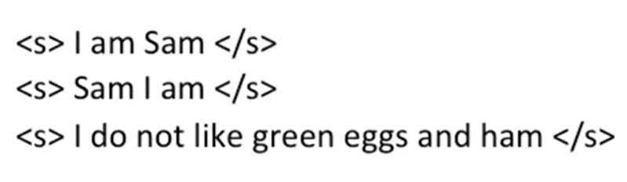












Exercise

Slide 26
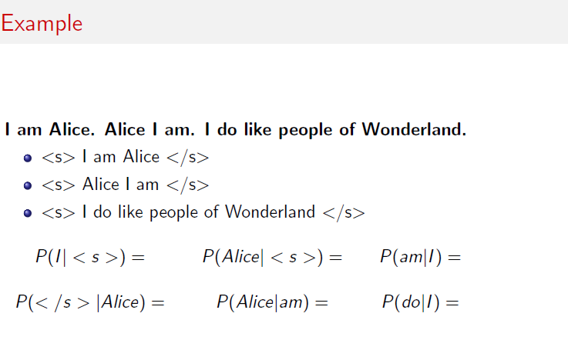
Exercise​

Slide 27
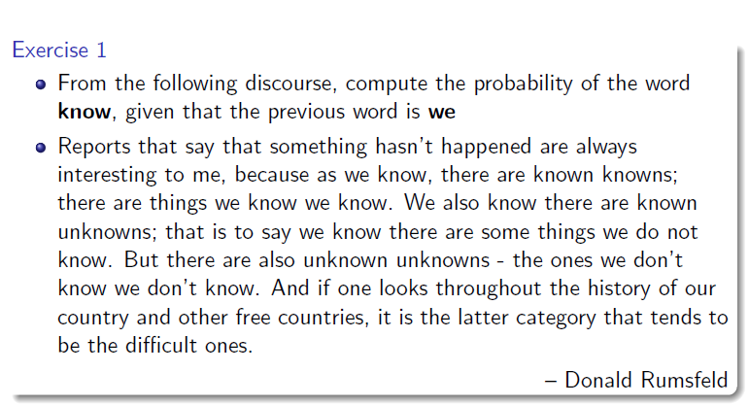
Exercise

Slide 28
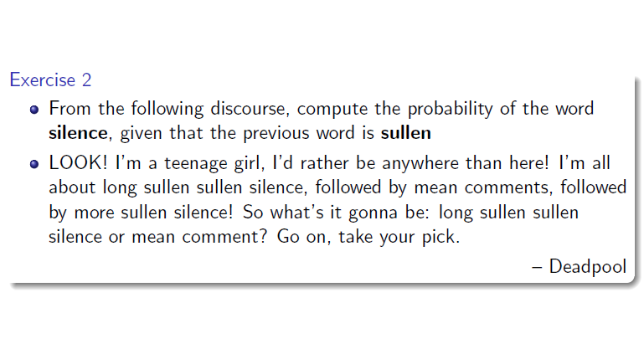

Slide 29
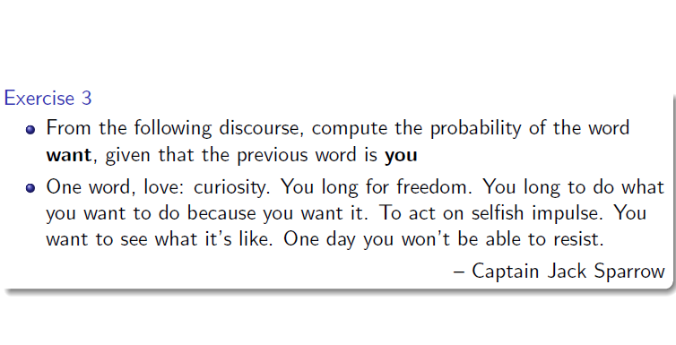

Slide 30
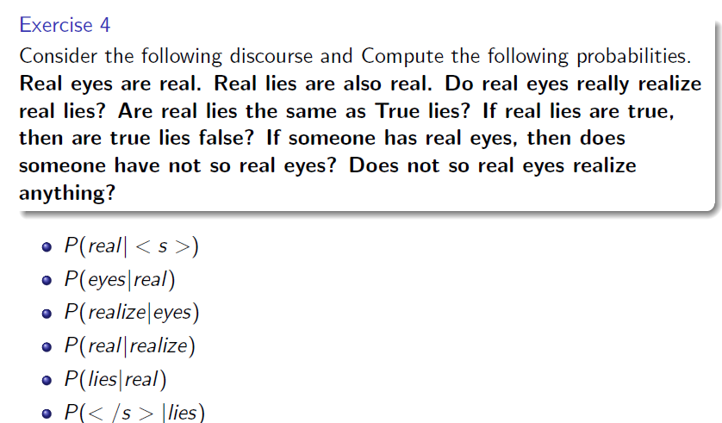

Slide 31
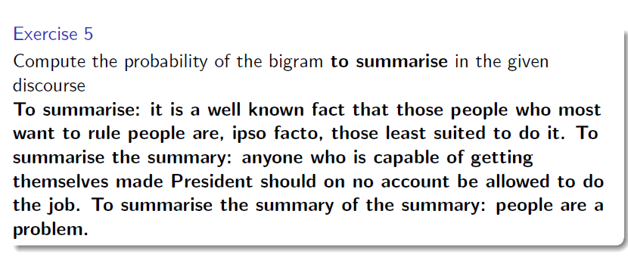

Slide 32
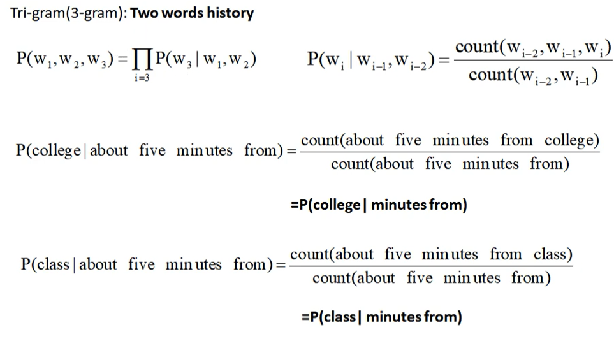
Example: Tri- gram

Slide 33
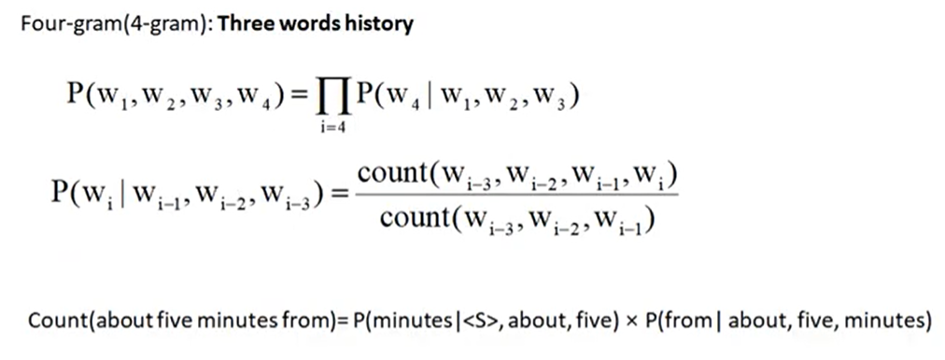
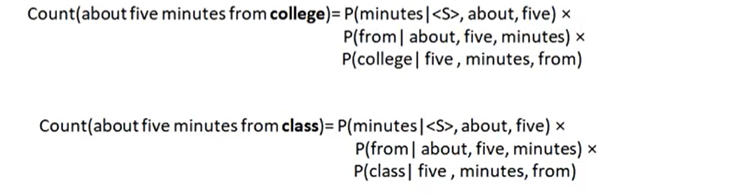
Example : Four- gram

Slide 34
Issue 1 Open vs. Closed Vocabulary
Closed Vocabulary Task
You know all the words in advance. The vocabulary V is fixed and complete — it's a sealed list, and nothing outside it can ever appear.
Because the word list is locked down, unknown words cannot occur by definition. Every word the model meets at test time is guaranteed to already be in V.
Example: a voice assistant that only understands a fixed command set — "play", "pause", "stop", "next". You defined the entire vocabulary yourself, so no surprise word can show up.

Slide 35
Open Vocabulary Task
You do not know all the words in advance. New, unexpected words will show up at test time. These are called Out-Of-Vocabulary (OOV) words.
This is the realistic setting for natural language, because language is unbounded — people use rare names, invent slang, borrow foreign words, make typos. You simply can't list every possible word beforehand.
Example: a system processing tweets or web text — you'll constantly hit words that never appeared in your training data.

Slide 36
Issue 2 Unknown words
The Problem
When building an n-gram language model, you need a vocabulary V. But you often encounter words at test time that were never seen during training. This creates two scenarios:
Closed vocabulary task — You know all possible words in advance, so V is fixed. Nothing unexpected can appear. This is rare in practice.
Open vocabulary task — You don't know all words in advance. New words show up that aren't in your vocabulary. These are called Out-Of-Vocabulary (OOV) words.

Slide 37
The Solution
<UNK> token
Instead of crashing or assigning zero probability to unseen words, you create a special token <UNK> (unknown) that stands in for any word not in your vocabulary.
Training <UNK> probabilities:
Fix a lexicon L of size V (decide which words are "known").
During text normalization, replace any training word not in L with <UNK>.
Then train probabilities for <UNK> exactly like any normal word — it accumulates counts from all the rare/replaced words.
At decoding (test) time:
Any input word not seen in training is treated as <UNK>, and you use the <UNK> probabilities you learned.

Slide 38
Why it matters
Without <UNK>, an unseen word would get probability 0, making the entire sentence probability 0. The <UNK> token gives the model a principled way to assign nonzero probability to novel words.

Slide 39
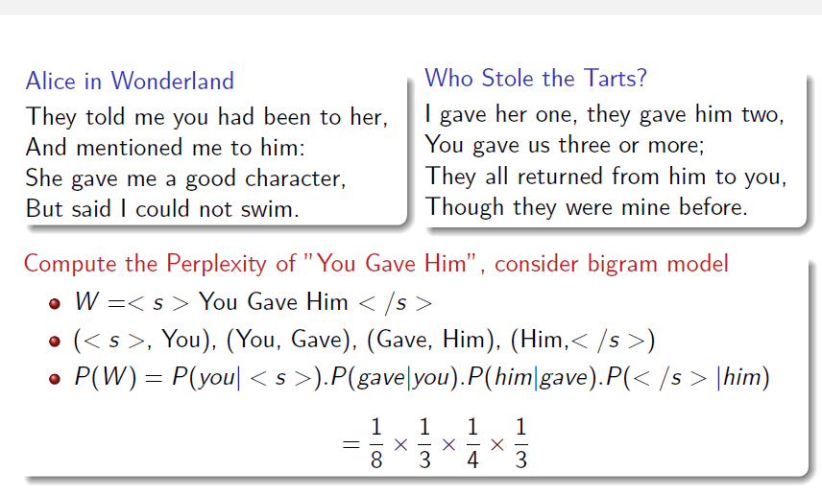
Issue 3
Zero probability

Slide 40
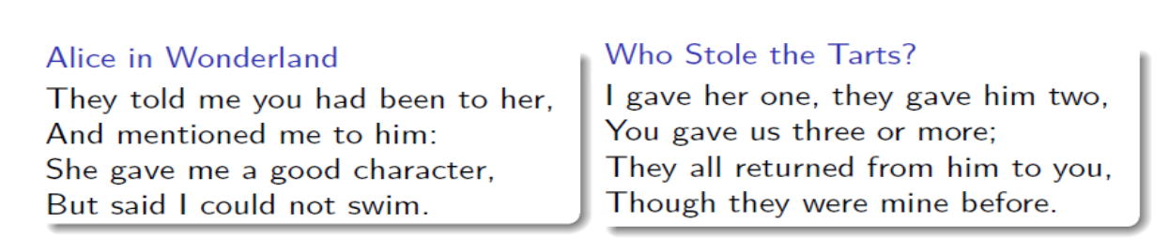
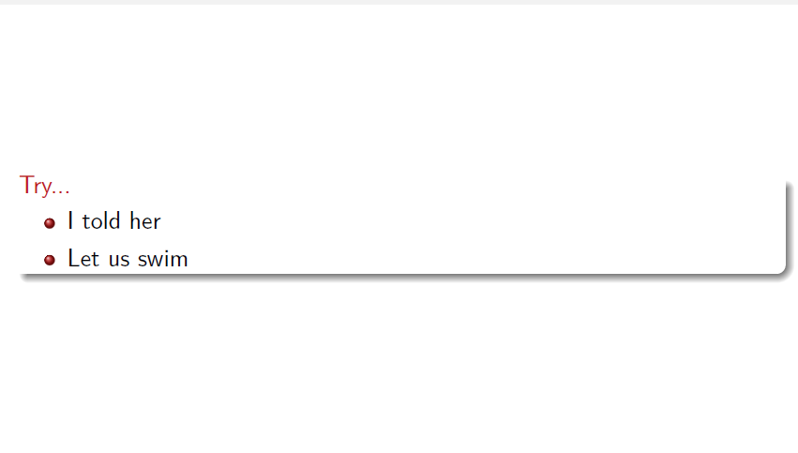

Slide 41
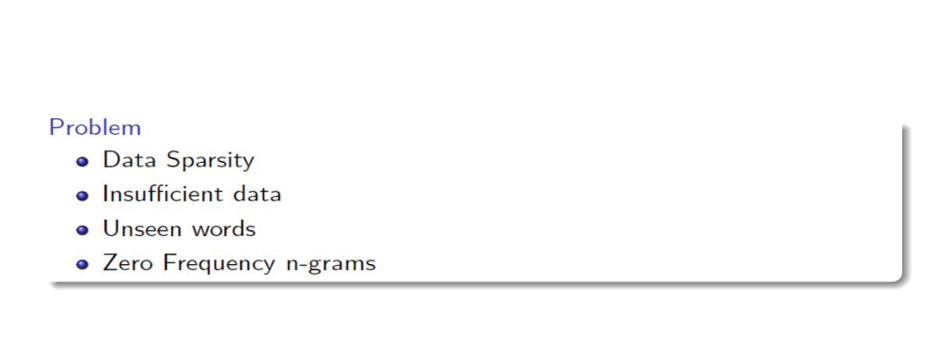

Slide 42
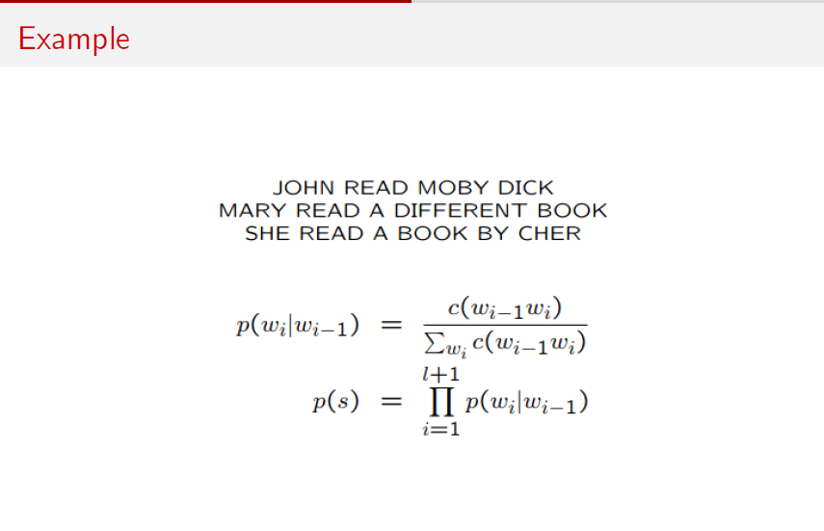

Slide 43
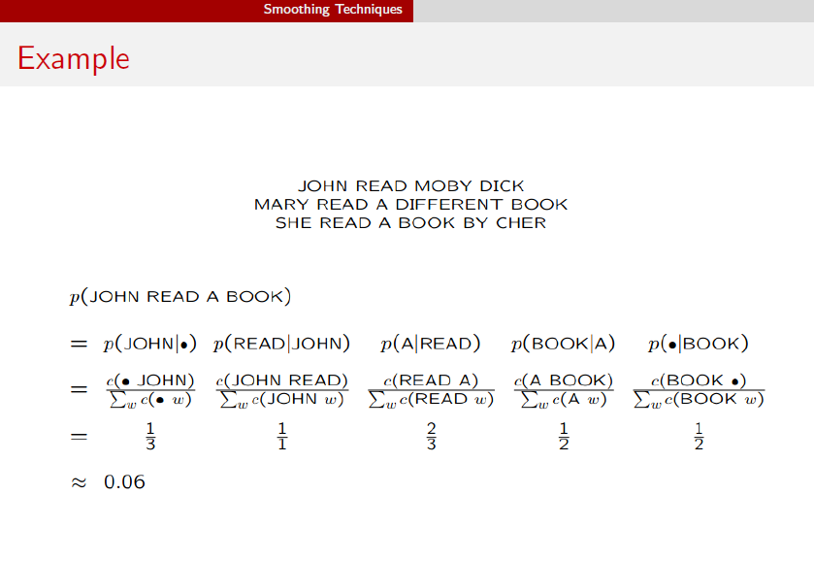

Slide 44
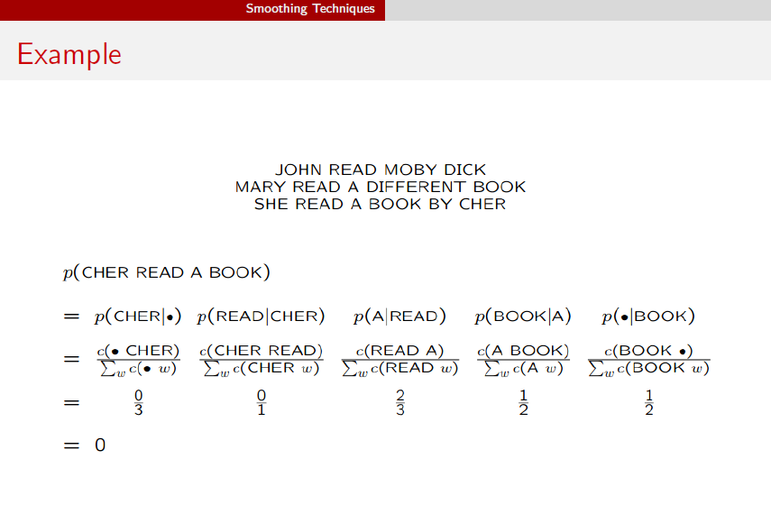

Slide 45
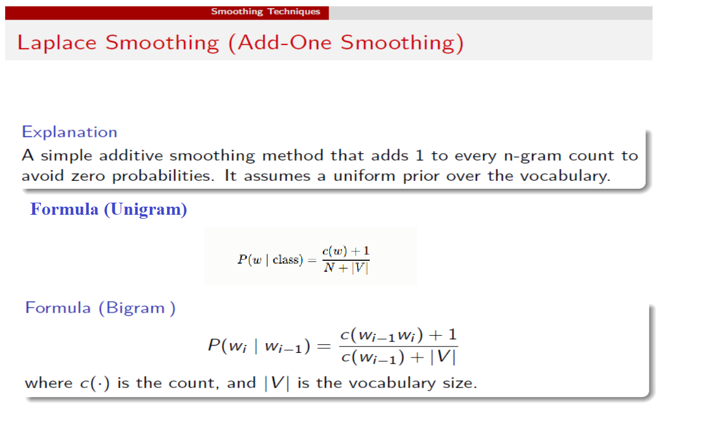

Slide 46
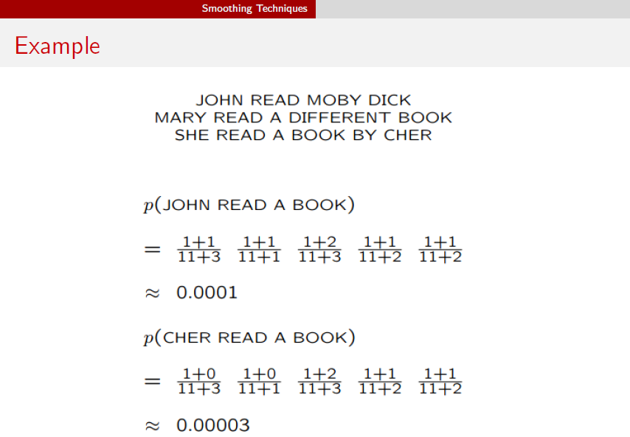

Slide 47
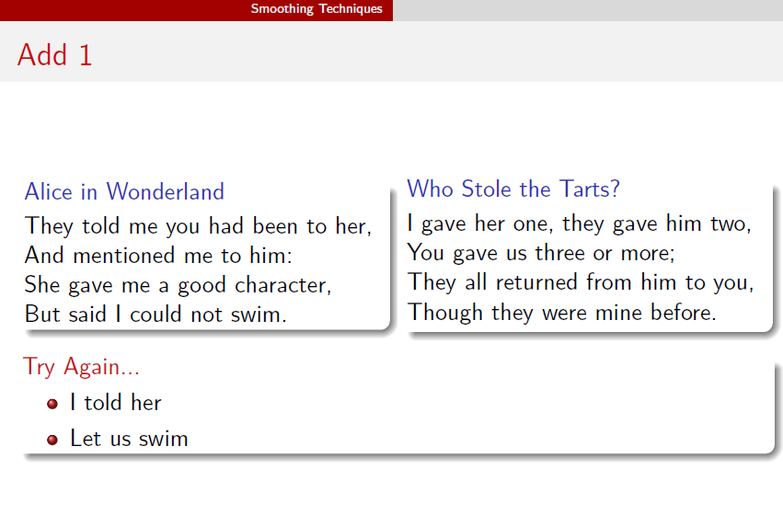

Slide 48
Exercise: Naive Bayes Spam Filter
Training statistics (SPAM class). From the SPAM training emails, the observed word counts are:
Problem. A Naive Bayes classifier labels an email as SPAM or HAM (legitimate) by multiplying the class-conditional probabilities of its words. We show how an unseen word forces a zero probability, and how Add-1 smoothing resolves it.
Vocabulary size (V): 08
Test email. "win free money meeting"
Word | Count in SPAM
Free | 6
Money | 5
Win | 4
Click | 3
Prize | 2
Meeting | 0
Project | 0
Lunch | 0
Total tokens | 20

Slide 49
Exercise: Sentiment Analysis of Product Reviews
Task: Classify a review as POSITIVE or NEGATIVE using Naive Bayes.
Training statistics (POSITIVE class): total N = 25 tokens, V = 10.
Word | Count in POSITIVE
great | 8
love | 6
excellent | 5
perfect | 4
amazing | 2
terrible | 0
refund | 0
broken | 0
Test review:
“The product is great but terrible and broken.”

Slide 50
Good Turing Discounting
Good Turing Smoothing technique uses the frequencies of the count of occurrence of N-Grams for calculating the maximum likelihood estimate.
For example, consider calculating the probability of a bigram (chatter/cats) from the corpus. Note that this bigram has never occurred in the corpus and thus, probability without smoothing would turn out to be zero. As per the Good- turing Smoothing, the probability will depend upon the following:
In case, the bigram (chatter/cats) has never occurred in the corpus (which is the reality), the probability will depend upon the number of bigrams which occurred exactly one time and the total number of bigrams.
In case, the bigram has occurred in the corpus (for example, chatter/rats), the probability will depend upon number of bigrams which occurred more than one time of the current bigram (chatter/rats) (the value is 1 for chase/cats), total number of bigram which occurred same time as the current bigram (to/bigram) and total number of bigram.

Slide 51
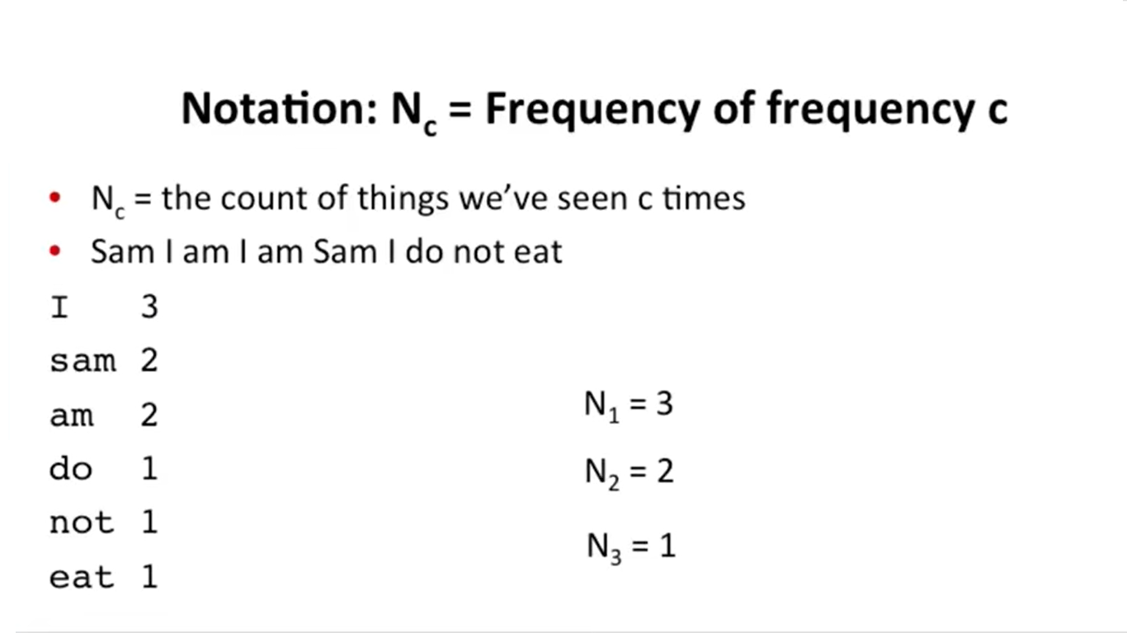
Good Turing Discounting

Slide 52
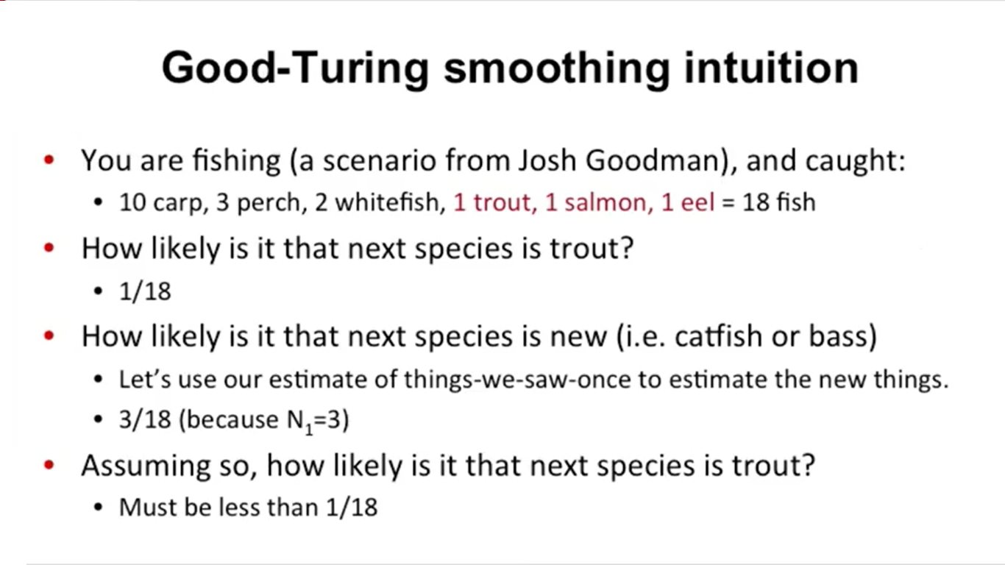

Slide 53
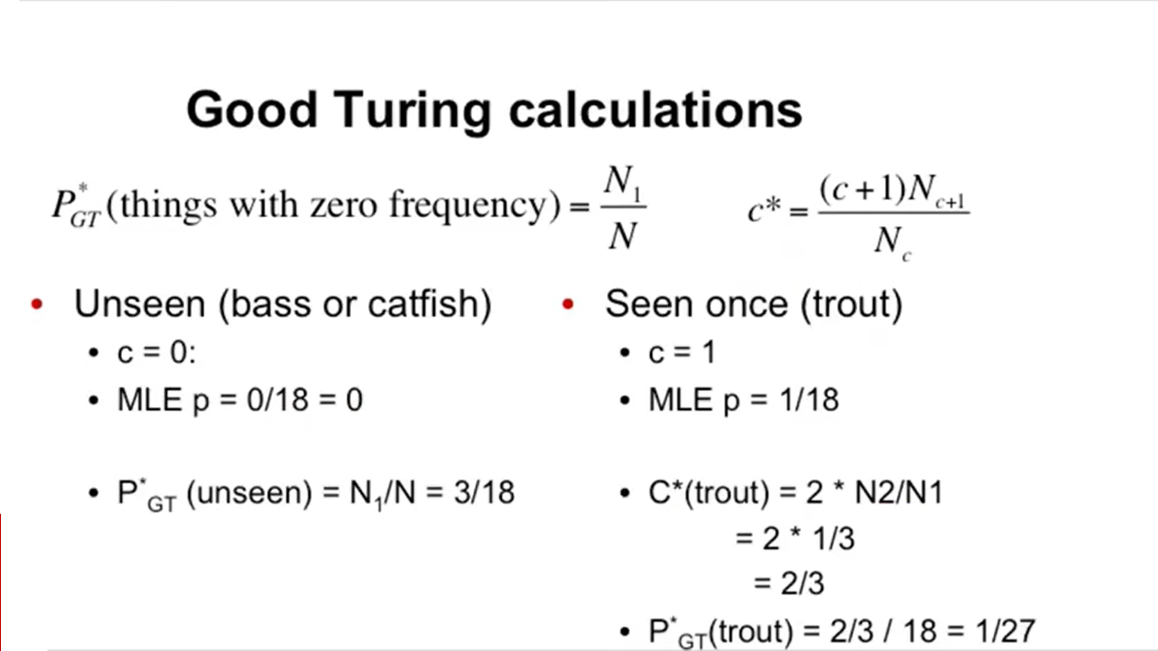

Slide 54
Evaluating language model
Assign higher probability to real ( or frequently observed) sentences than ungrammatical (or rarely observed) ones.
Training and test corpora
Parameters of the model are trained on a large corpus of text, called training set.
Performance is tested on a disjoint test data using an evaluation metric.

Slide 55
Extrinsic evaluation of N- grams models
Extrinsic = judge the model by how well it helps a real application.
Comparison of two models, A and B
Use each model for one or more tasks: spelling corrector, speech recognizer, machine translation
Run the task, get accuracy values for A and B
-How many misspelled words corrected properly
- How many words translated corrected
Compare accuracy for A and B
Disadvantage:
Expensive
Time consuming

Slide 56
Intrinsic evaluation : Perplexity
Intrinsic = judge the model directly, without any downstream task.
Intuition : The Shannon Game ( Given a context, can the model predict the next word?)
I always order pizza with cheese and …
The president of India is….
I wrote a …….
Unigram model does not work for this game
A better model of text is one which assigns a higher probability to the actual word.
The language model is best when it predicts an unseen test set.

Slide 57
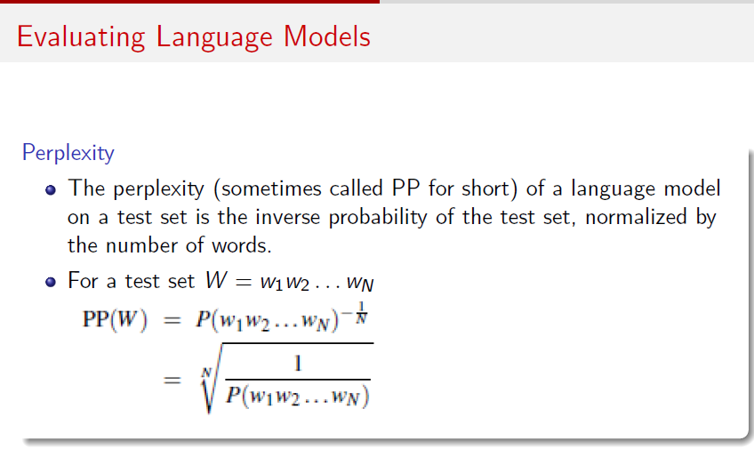

Slide 58
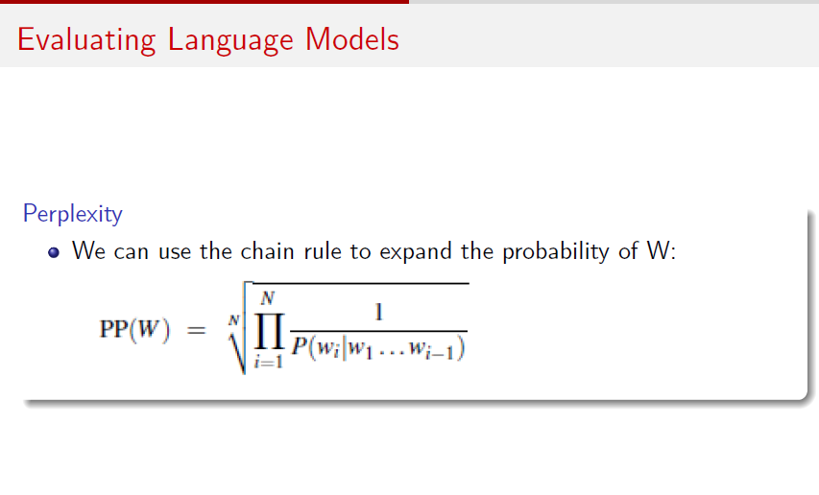

Slide 59
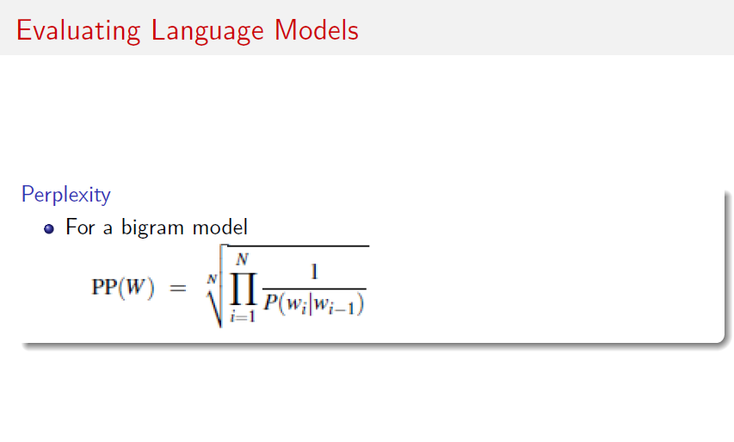

Slide 60
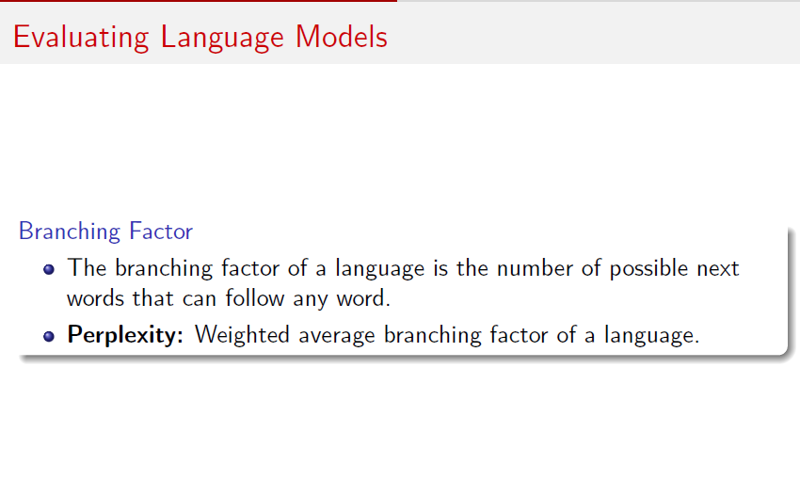
Lower perplexity = better model

Slide 61
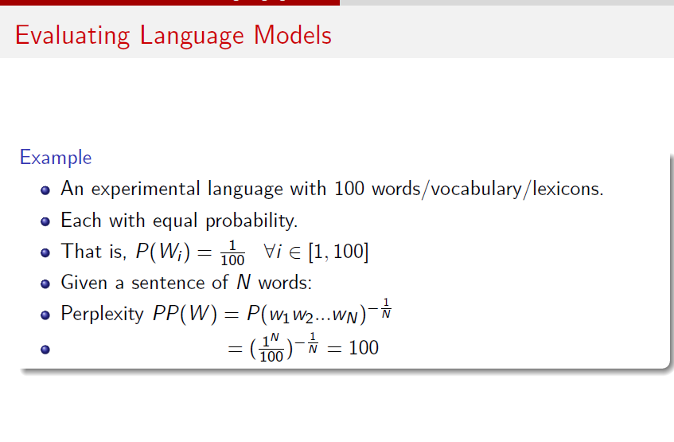

Slide 62
Exercise 1
Compute the perplexity of the sentence “She likes mangoes” using a bigram language model constructed from the given text corpus:
She likes apples.She likes bananas.He likes mangoes.They eat fruits.She likes grapes.

Slide 63
Exercise 2
Compute the perplexity of “I like sweets”, by considering the bigram model from the following text.
I like many things to eat. I like cake. I like biscuits. And, yes, sweets. I do like them. I like jam. It is like sweets.

Slide 64
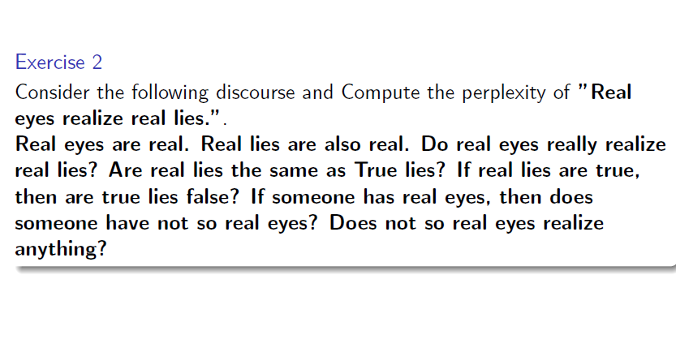

Slide 65
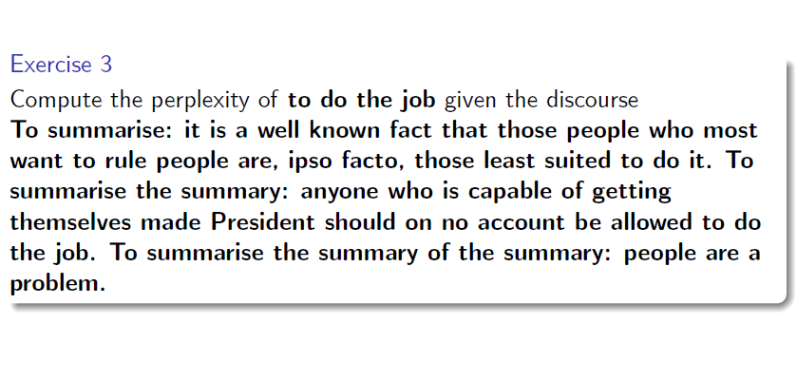

Slide 66
Exercise 4
Compute the perplexity of the sentence “We enjoy music” using a bigram language model constructed from the given text corpus:
We enjoy sports.They play music.We love dancing.Students enjoy learning.Music makes life better.

Slide 67
Exercise 5
A hospital compares two unigram language models on the same five-word medical sentence:
The patient feels very weak
The models produce the following sentence probabilities:
PModel_A(W)=0.00008,PModel−B(W)=0.00002 N=5(Number of words)
The healthcare analytics team states:
“Model B is better because its probability value is smaller.”
a) Calculate the perplexity of Model A.
b) Calculate the perplexity of Model B.
c) Determine which model is better based on perplexity and explain why.
d) The medical report contains the phrase:
“patient feels weak”
Explain one limitation of using a unigram model for this phrase and suggest a more appropriate n-gram approach.

Slide 68
Doubts
i) When to calculate smoothing?
Ans: When we want to prevent zero probabilities.
ii) If probability is not coming as zero then what to do?
Ans: The model can compute sentence probabilities and perplexity normally. Smoothing is not mandatory.Even if no zeros exist, some events may have very low probabilities. Smoothing adjusts those probabilities.This improves generalization when new/unseen data arrives later.
iii) When I am comparing two sentences should I go with same method or different(with smoothing or without)
Ans: Always use one consistent method (either with smoothing or without) when comparing multiple sentences under the same model.
Conclusion:
1. If both sentences contain only known words/n-grams → you can apply without smoothing.
2. If there is a chance of unknown or unseen words/n-grams in either sentence → apply with smoothing for both.
3. Use a consistent method.

Slide 69
Doubts
Iv)Why do we need smoothing if we can add the new word? Ans: Adding a new word to the vocabulary does not change its count; if it was unseen, (C(w)=0), so it still gives probability 0.
Smoothing assigns a non-zero probability to unseen words/events using techniques such as Laplace or Good–Turing. Q2. How many unseen words can we test? Is there any limit? Ans: There is no fixed limit. It depends on the vocabulary being considered. All unseen words share the probability mass reserved for unseen events. Q3. Is N1 /N the probability of each unseen word? Ans: No. N1 /N is the total probability mass assigned to all unseen events.

Slide 70
Statistical text representation techniques
Bag of Words (BoW)
TF-IDF (Term Frequency–Inverse Document Frequency)

Slide 71
Bag of Words (BoW)
Bag of Words is a statistical text representation technique that represents a document using the frequency or presence of words from a predefined vocabulary, while ignoring the order and grammatical structure of the words.
It represents text using word counts or word presence.
It creates a vocabulary from the corpus.
Each document is represented as a numerical vector.
Word order is ignored.
Grammar and meaning are not directly represented.
It can produce a sparse vector when the vocabulary is large.

Slide 72
TF-IDF
TF-IDF is a statistical text representation technique that assigns a numerical weight to a word based on how frequently the word occurs in a particular document and how rarely it occurs across the entire collection of documents.

